Slide 1
Introduction to demand
Desire, want, demand.
Desire is just a wishful thinking not backed by the ability to pay for the product.
The person who desires or wants to have a product must have the ability to buy and willingness to pay for that product, only then is that desire called a demand.

Slide 2
Classification of goods and services
Free goods: goods that have no production cost. These are gift of nature such as sunlight, river water and air.
Public goods: goods that are used and are of benefit to everyone. E.g. public clinics, schools and others.
Economic goods and services: goods that involve a cost of production.
Economic goods are also thing of value that can be seen and touched eg. Books, clothes, houses and so on.
Economic services are intangible things which cannot be seen or touched eg. Medical care, legal services and cinemas.

Slide 3
Demand
Demand is defined as the ability and willingness to buy specific quantities of goods in a given period of time at a particular price, ceteris paribus.
Ceteris paribus is a Latin phrase that means holding other factors constant while some other factors change.

Slide 4
Law of Demand
The law of demand states that higher the price of a product, the lower the quantity demanded of that product and lower the price of a product, the higher the quantity demanded, ceteris paribus.

Slide 5
Assumption
Taste and preferences of consumers remain unchanged.
Consumers’ income remain same.
Price of related goods should remain unchanged.
Goods should not have any prestige value.

Slide 6
Demand schedule
The demand schedule for a product is a list of the quantity that a buyer is willing to buy at different prices at one particular time.
It represents functional relationship between price and quantity demanded.

Slide 7
Demand Schedule
Price (Rs. ) | Quantity (units)
5 | 2
4 | 4
3 | 6
2 | 80
1 | 10

Slide 8
Demand curve
Demand curve is diagrammatic representation of demand schedule which shows the inverse relationship between the price and quantity demanded of the product.

Slide 9
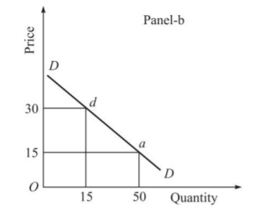
Demand curve

Slide 10
Types of demand
Direct and derived demand
Complementary and competing goods
Consumer and capital goods
Perishable and non-perishable goods
Individual demand curve
Market demand curve
Cross demand: **Positive Cross Price Elasticity (Substitutes) Positive Cross Price Elasticity occurs when the formula produces a result greater than 0.**
Negative Cross Price Elasticity (Complementary)
Unrelated Cross Price Elasticity.

Slide 11
Types of demand
Individual demand
Market demand
The relationship between the quantity of a product demanded by single individual and its price
The relationship between the total quantity of product demanded by all consumers in the market and its price.

Slide 12
Price (Rs.) | Individual 1 | Individual 2 | Market demand
5 | 2 | 4 | 6
4 | 4 | 5 | 9
3 | 6 | 6 | 12
2 | 8 | 7 | 15
1 | 10 | 8 | 18

Slide 13
Determinant demand curve
Internal factors
External factors
Price of goods
Service policies or terms of payment
Profit margin
Price of related goods
Substitute goods
Complementary goods

Slide 14
General Factor
Consumer’s income
Consumers’ fashion, taste and preferences
Population or number of buyers
Expectation about future prices
Advertisement
Festive seasons and climate (seasonal fluctuation)
Level of taxation
Supply of money in circulation

Slide 15
Technological changes or achievements
factor to determine the demand of products and entire production
Efficiency
Technology can contribute to the efficiency of a business's output rate, allowing for larger quantities of products to be moved or of services to be rendered
Specialization
Technology has lead to an increase in the division of labor and specialization of jobs within a business, further contributing to the efficiency with which a business is able to run
Optimum use of Natural Resources
Technology has a huge effect on the ability of businesses and governments to access natural resources and use them in the most effective ways possible to benefit both the business and the economy.

Slide 16
Industrial Expansion
Thanks to the increased efficiency of labor with the ever-improving state of technology, businesses are able to increase total output, which in turn leads to higher profits and greater economic development.
Research
Better technology has lead to further research into nearly every sector of business and science, meaning businesses can benefit from all sorts of technological advancements.
International Trade
Information technology is the single most important element in the success and growth of international trade and job market growth, allowing businesses to share information and conduct trade in very less time.

Slide 17
Changes in quantity demanded vs. changes in demand
Changes in quantity demanded
Changes in demand

Slide 18
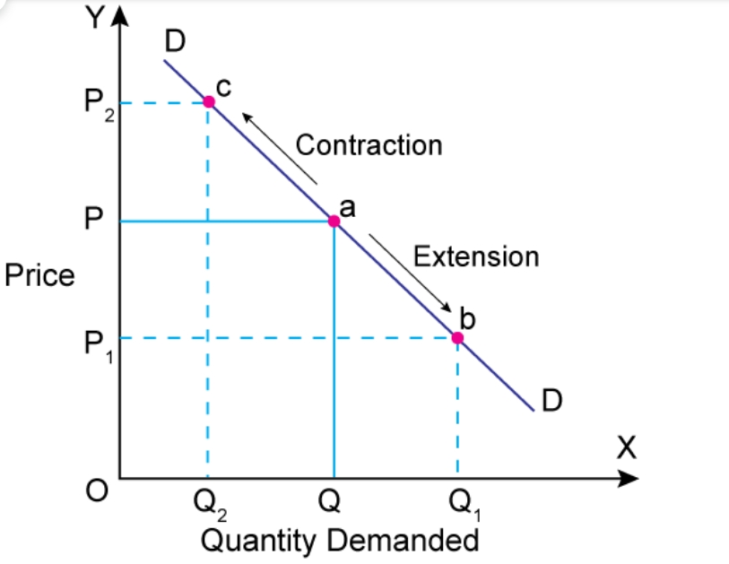

Slide 19
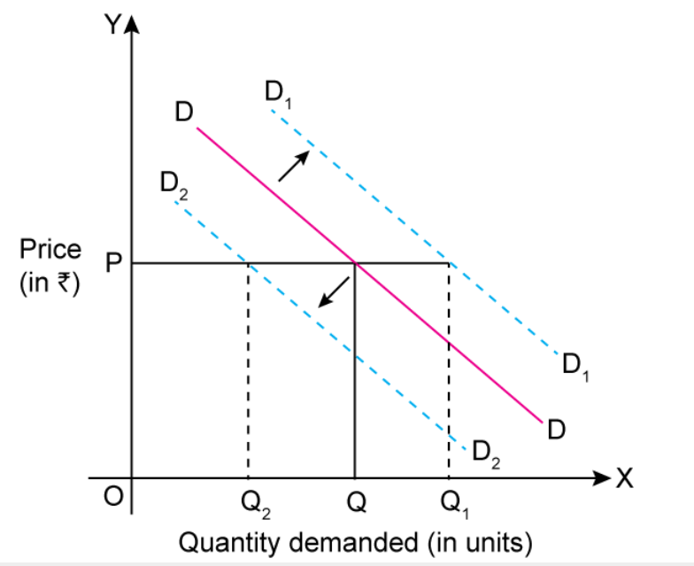

Slide 20
Changes in quantity demanded
If the price of a product change and other factors are constant, there will be a movement along the demand curve.
The upward movement along the demand curve represent the decrease in quantity demanded.
The downward movement along the demand curve represent the increase in quantity demanded.

Slide 21
Change in demand
If the price of a product is constant and other factors change there will be a shift of demand curve.

Slide 22
Reasons for shift in demand curve
Occurs when there are changes in other factors such as population, income, price of related goods etc.

Slide 23
Demand curve shifts to right if
Price of substitute goods increases
Price of complement goods decreases
Income increases
Expected future price increases
Number of buyers increases

Slide 24
Demand curve shifts to left if
Price of substitute goods decreases
Price of complement goods increases
Income decrease
Expected future price decreases
Number of buyer decrease

Slide 25
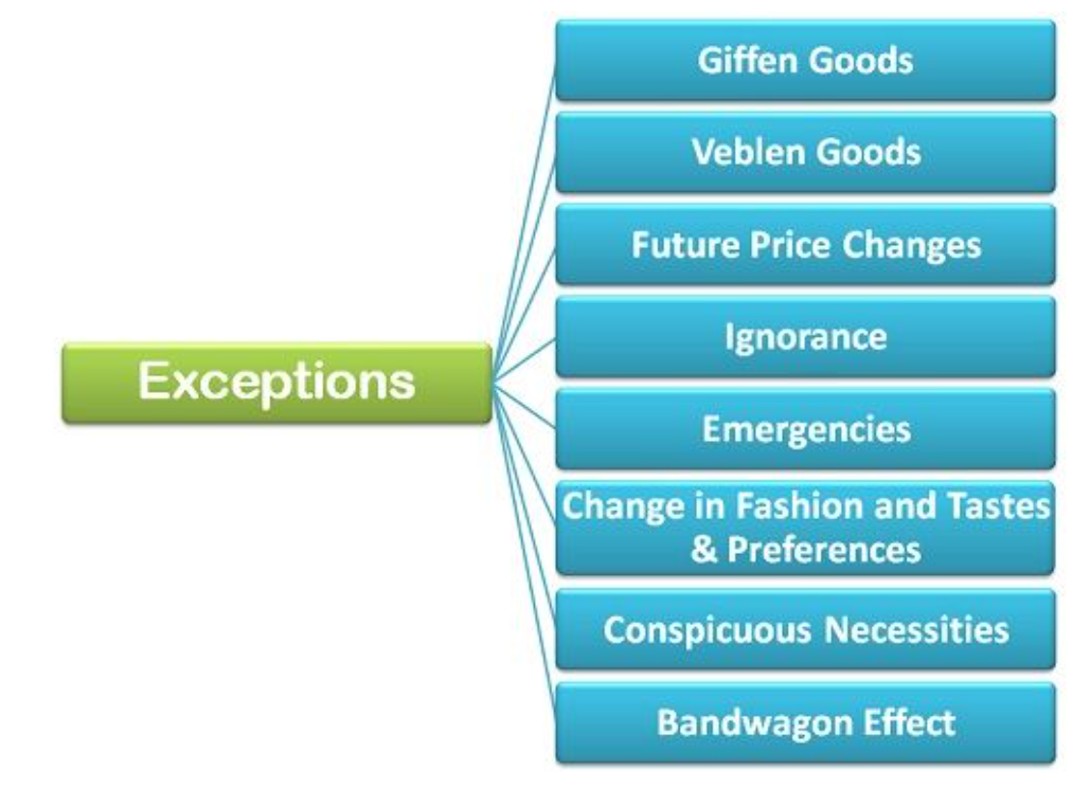

Slide 26
Exceptional demand
Giffen goods
Status symbol goods- Veblen good
Emergencies
Highly- priced goods

Slide 27
Giffen Goods
Exception to the law of demand was pointed out by Robert Giffen.
Such goods in whose case there is a direct price-demand relationship are called Giffen goods.
It is important to note that with the rise in the price of a Giffen good, its quantity demand increases and with the fall in its price its quantity demanded decreases, the demand curve will slope upward to the right and not downward. by Robert Giffen

Slide 28
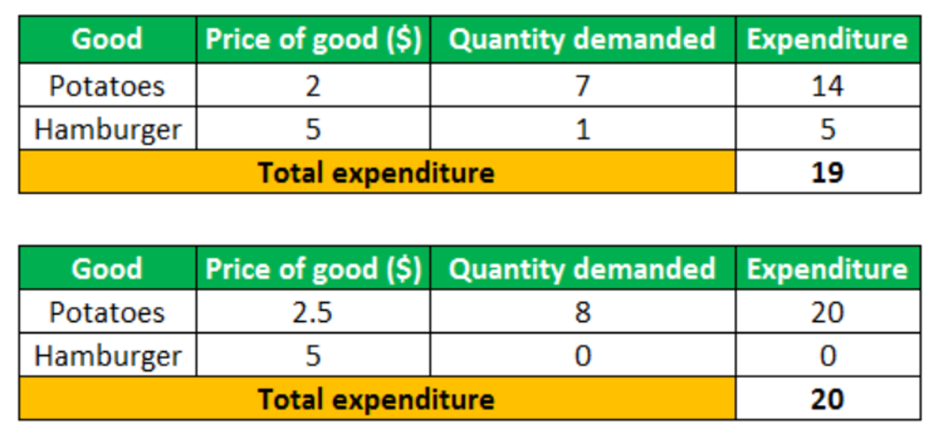
Schedule for Giffen good
It is important to note that all Giffen goods are inferior, but not all are Giffen goods.

Slide 29
Status symbol goods- Veblen good
Expensive Items- a status symbol goods
Expensive goods such as luxury vehicles and watches that can cost more than a down payment on a home are mostly out of reach for lower economic classes. For this reason, they have become status symbols.
Because much of the utility derived from status symbols comes from their high price, if the price of a status symbol goes up it may actually increase its demand, rather than diminish it. A product that exhibits this phenomenon is known as Veblen goods.

Slide 30
Conspicuous Necessities:
There are certain commodities which have become essentials of the modern life. These are the goods that consumer buys irrespective of an increase in the price. For example TV, refrigerator, automobiles, washing machines, air conditioners, etc.
Bandwagon Effect: This is the most common type of exception to the law of demand wherein the consumer tries to purchase those commodities which are bought by his friends, relatives or neighbors. Here, the person tries to emulate the buying behavior and patterns of the group to which he belongs irrespective of the price of the commodity.
For example, if the majority of group members have smartphones then the consumer will also demand for the smartphone even if the prices are high or any particular brand associated product it can be.

Slide 31
NETWORK EXTERNALITIES : BANDWAGON EFFECT AND SNOB EFFECT
Network externalities are a special kind of externalities in which one individual’s utility for a good depends on the number of other people who consume the commodity.
Bandwagon Effect
The existence of positive network externalities gives rise to Bandwagon effect. The bandwagon effect refers to the desire or demand for a good by a person who wants to be in style because possession of a good is in fashion and therefore many others have it.
It may be noted that this bandwagon effect is the important objective of marketing and advertising strategies of several manufacturing companies that appeal to go in for a good as people of style are buying it.

Slide 32
Conti…..
bandwagon effect is an example of a positive network externality in which the quantity demanded of a good that an individual buys increases in response to the increase in the quantity purchased by other individuals.
Snob Effect
In case network externalities are negative, the snob effect arises. The snob effect refers to the desire to possess a unique commodity having a prestige value.
Snob effect works quite contrary to the bandwagon effect. The quantity demanded of a commodity having a snob value is greater, the smaller the number of people owning its. Rare works of art, specially designed sport cars, specially designed clothing made to order, very expensive luxury cars.
For example, the utility one gets from a very expensive luxury car is mainly due to the presitge and status value of it which results from the fact that only few others own it.

Slide 33
Interrelated demand
Cross demand: the demand for good is effected by price of its substitute or complementary goods. The relationship between the price of substitute or complementary goods and quantity demanded of a good is what we call cross demand.
Derived demand
Composite demand: is the demand for a good that has multiple uses e.g. sheep can be used for mutton and wool, milk for curd and cheese. If there is increase in demand for curd then the supply of milk will be less for cheese.

Slide 34

PRICE ELASTICITY OF DEMAND
Price elasticity of demand indicates the degree of responsiveness of quantity demanded of a good to the change in its price, other factors such as consumers’ income, prices of related commodities that determine demand are held constant.
Price elasticity of demand is defined as the ratio of the percentage change in quantity demanded of a commodity to a given percentage change in price.

Slide 35
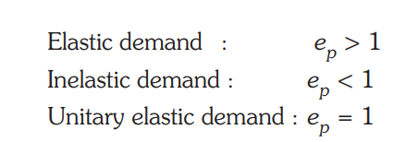
Types of elasticity:

Slide 36
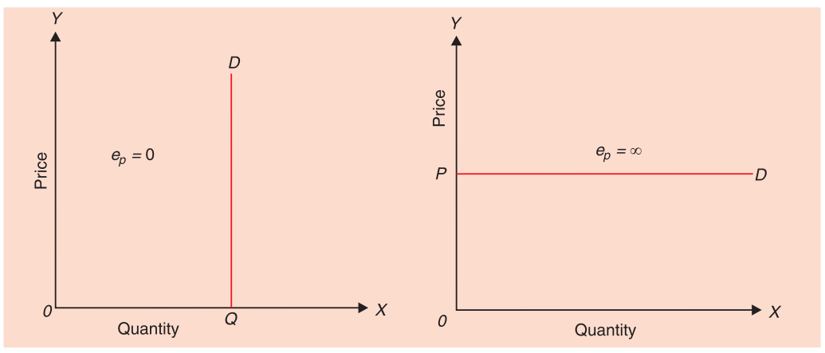
Perfectly Inelastic Demand Perfectly Elastic Demand

Slide 37
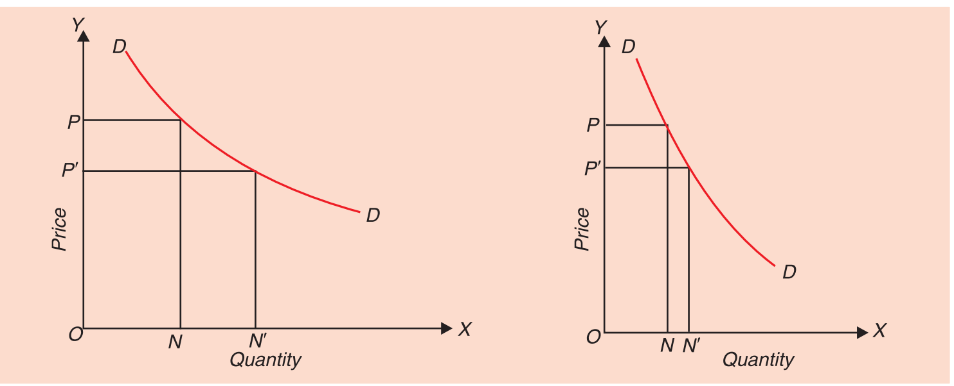
Elastic and Inelastic demand

Slide 38

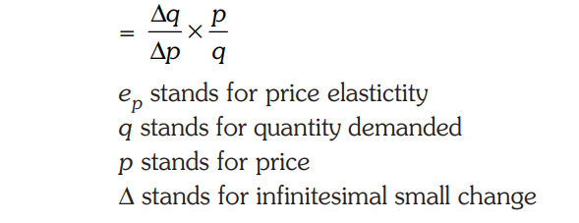
Conti…..

Slide 39
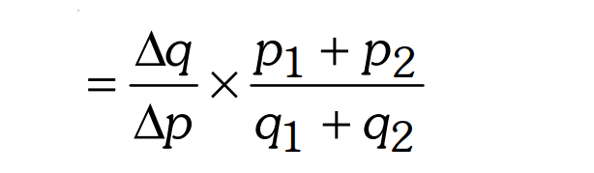
Mid point method
It should be carefully noted that for large changes in price, we must use the midpoint method of calculating price elasticity of demand. If the change in price is very small, then we can use initial price and the initial quantity demanded.

Slide 40
Questions:
Consider the demand for a good. At price Rs 4, the demand for the good is 25 units. Suppose price of the good increases to Rs 5, and as a result, the demand for the good falls to 20 units. Calculate the price elasticity?
Suppose the price elasticity of demand for a good is -0.2. If there is a 5% increase in the price of the good, by what percentage will the demand for the good go down?

Slide 41
Degree of price elasticity of demand
Elastic demand: eg. Substitute goods
Inelastic demand: eg. Low substitute like petrol and cigarettes.
Unitary elastic demand
Perfectly inelastic demand: eg. demand for insulin or other medicine
Perfectly elastic demand

Slide 42
Determinants of price elasticity of demand
Existence of substitutes
Proportion of expenditure on a good
Nature of goods
Income levels
Time dimensions
Habits
Complementary goods
Frequently purchased products

Slide 43
Income elasticity of demand
Income elasticity of demand measures the responsiveness of changes in quantity demanded for a product due to change in income.
Consumer’s income will effect the demand for different products.

Slide 44
Income elasticity of demand= %change in quantity demanded
% change in income

Slide 45
If income increases from Rs. 1000 to Rs. 2000 and the quantity demand for the product increases by 20 to 30 units, calculate income elasticity of demand.

Slide 46
Practical importance of income elasticity of demand
Forecasting
Promotional strategy

Slide 47
Cross elasticity of demand
Cross elasticity of demand measures the responsiveness of quantity demanded for a product due to change in price of related product.

Slide 48
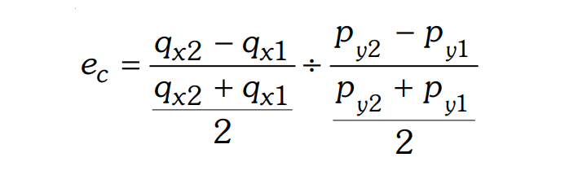
Cross elasticity of demand= %change in quantity demanded of good X
%change in price of good Y

Slide 49
Question:
If price of coffee rises from Rs. 45 per pack to Rs. 55 per pack of 250 grams and as a result the consumers demand for tea increases from 600 packs to 800 packs of 250 grams, then find the cross elasticity of demand of tea for coffee.

Slide 50
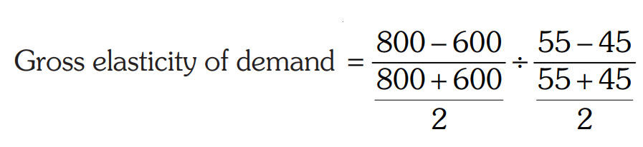
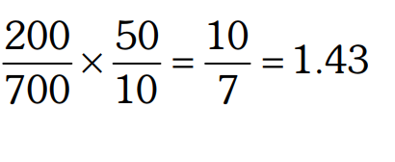
Solution:

Slide 51
Supply
Supply is defined as the ability and willingness to sell or produce a particular product or service in a given period of time at a particular price, ceteris paribus.

Slide 52
Law of supply
Law of supply states that higher the price of a product, the greater the quantity supplied of that product and lower the price of a product, lower the quantity supplied, ceteris paribus.

Slide 53
Assumptions
Cost of production remains constant
Number of sellers remains the same
Price of related goods does not change
Availability of other inputs remains unchanged.

Slide 54
Supply schedule
The supply schedule for a product is a list of the quantity supplied at different prices, assuming all other influences are constant.
The supply schedule represents a functional relationship between price and quantity supplied.

Slide 55
Price (Rs) | Quantity S.
5 | 10
4 | 8
3 | 6
2 | 4
1 | 2

Slide 56
Types of supply
Individual supply
Market supply
The relationship between the quantity of a product supplied by a single seller and its price.
The relationship between the total quantity supplied by all sellers in the market and its price.

Slide 57
Market Supply
Price | Seller A | Seller B | Market supply
5 | 10 | 8 | 18
4 | 8 | 7 | 15
3 | 6 | 6 | 12
2 | 4 | 5 | 9
1 | 2 | 4 | 6

Slide 58
Determinants of supply
Price of related goods
Cost of production
Expectations about the future prices
Technological advancement
Number of sellers
Government policies
Improvement in infrastructure

Slide 59
Change in quantity supplied and change in supply
Change in quantity supplies: movement along the supply curve
Change in supply: shift in supply curve

Slide 60
Supply curve shift rightward if
Price of substitute goods decreases
Price of complementary goods increases
Price of input decreases
Expected future price decreases
Increase in number of sellers
Government provides subsidy to sellers

Slide 61
Supply curve shift to left if
Price of substitute goods increases
Price of complementary goods decreases
Price of inputs increases
Expected future price increases
Decrease in number of sellers
Government impose tax on sellers

Slide 62
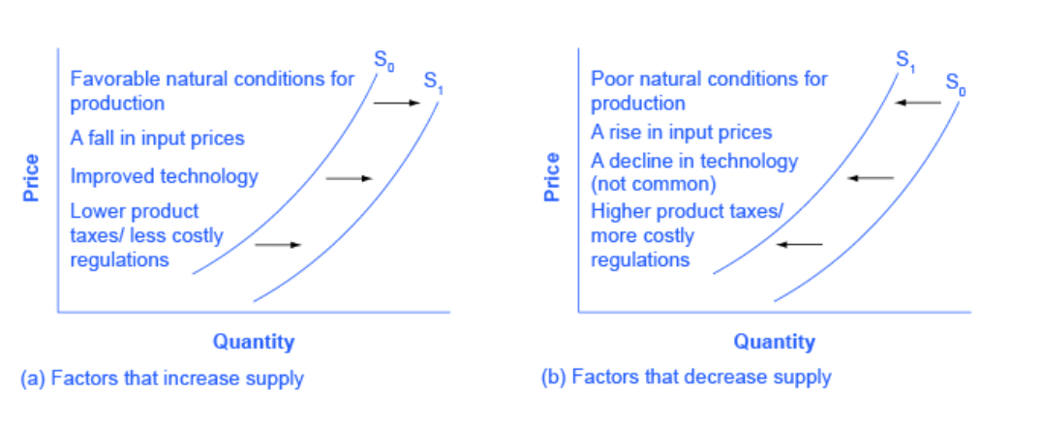
Rightward of Leftward shift

Slide 63
Equilibrium of quantity demand and quantity supply
Equilibrium is a situation when the quantity demanded and quantity supplied are equal.
There is no tendency for price or quantity to change
There is no tendency for the market price to increase or decrease.

Slide 64
Equilibrium price and output
Price | Quantity demanded | Quantity supplied | Market condition
5 | 2 | 10 | 10-2=8
4 | 4 | 8 | 8-4=4
3 | 6 | 6 | 6-6=0
2 | 8 | 4 | 4-8= -4
1 | 10 | 2 | 2-10= -8

Slide 65
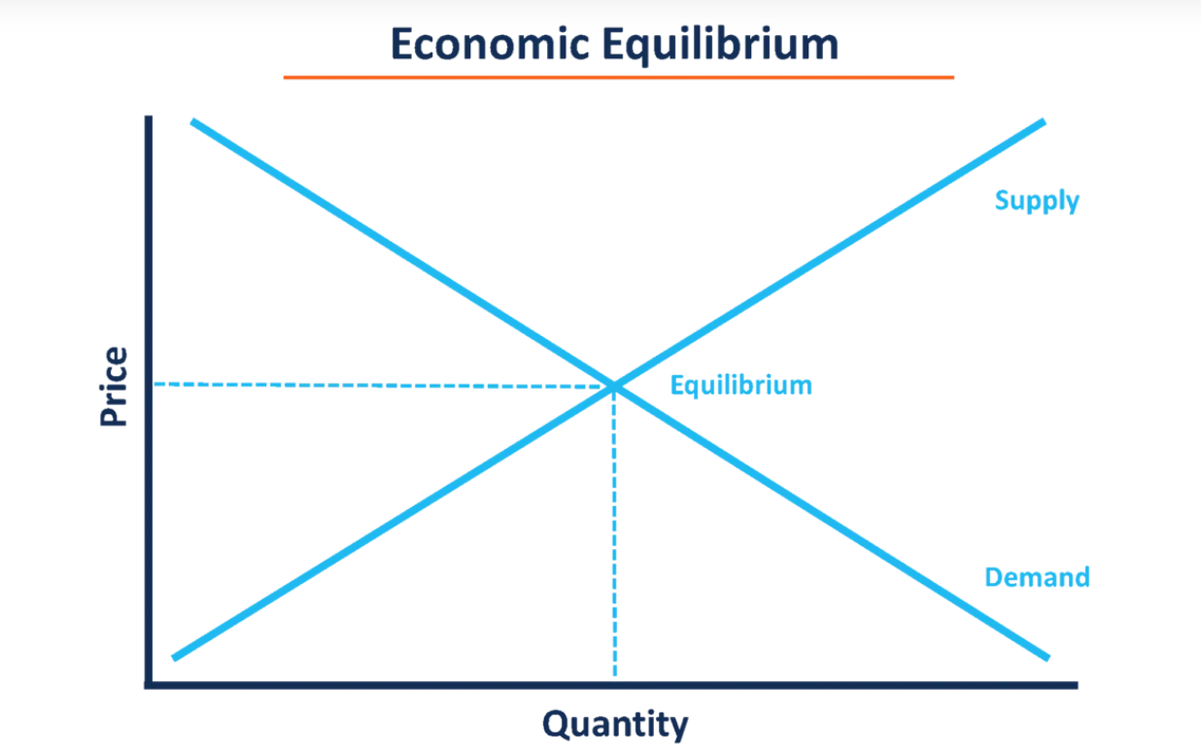

Slide 66
Disequilibrium and excess supply
Shortage
Surplus

Slide 67
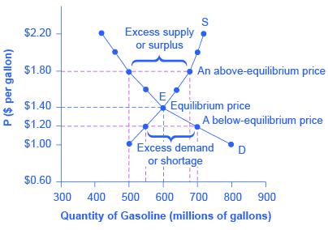

Slide 68
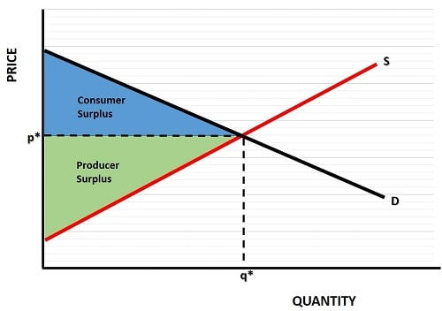
Consumer and Producer surplus

